Slide 1

Camden
Mental Health Support Team (MHST)
Information for Camden Primary School Parents

Slide 2
Welcome!
Who are we?
Angela Mngaza – School practitioner in Kentish Town Primary School
Shany Gur- Arieh – School practitioner
Notes:
Together
Mention that the team is made up of clinician from different modalities: psychologists, school practitioners

Slide 3

Understanding the role and work of the MHST
What is MHST?
Established in 2019 to provide Mental Health and Emotional Wellbeing support in schools by:
Working directly with children, young people and families
Working with school staff to promote awareness and develop the school’s approach to mental health and wellbeing
3. Giving advice and signposting
Notes:
Angela:
MHST were established in 2019 by the government and NHS England (?) to provide mental health and emotional wellbeing support in primary and secondary schools.
There are three main functions for MHST’s.
They are:
To deliver evidence-based interventions for mild-to-moderate mental health needs.
Support schools in developing their whole school approach to mental health and emotional wellbeing.
Give advice and signposting to school staff and liaise with external specialist services to help children and families get the right support.

Slide 4
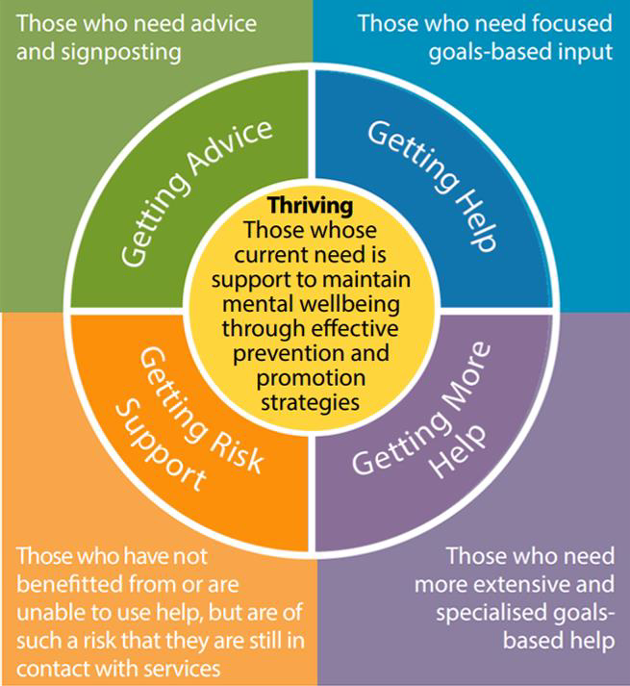
MHST
MHST
CAMHS
CAMHS
Notes:
Shany
MHST’s work within the Thrive framework. This framework was developed to define 4 kinds (type/areas?) of need: speak to the outer part of the grid.
This image shows where MHST fits within this framework. We aim to support children through getting advice and providing therapeutic support. For those who need more support we can assist by signposting and referring on to more specialist CAMHS services.
While CAMHS colleagues also give advice and give help, MHST is only active here in top part of the grid.

Slide 5
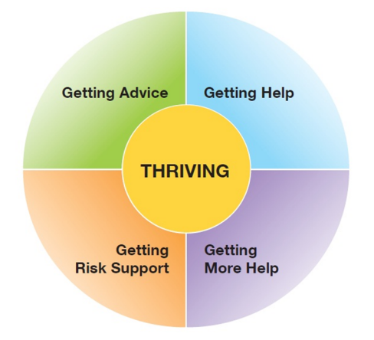
How we aim to help young people ‘Thrive’
The level of intervention and support we provide
We work with young people, their families and schools with the ‘advice’ and ‘getting help’ segments. To do this we work at a Universal, Targeted and Individual level
Universal: For everyone such as a lesson/workshop for all pupils and parents
Targeted: For a group of young people or parents
Individual: For one child or parent/child
Notes:
Shany
We mentioned before that one of the core functions is working directly with CYP and families and we do this on these three levels
Speak to the slide
And we will go in to this in more detail later on….

Slide 6
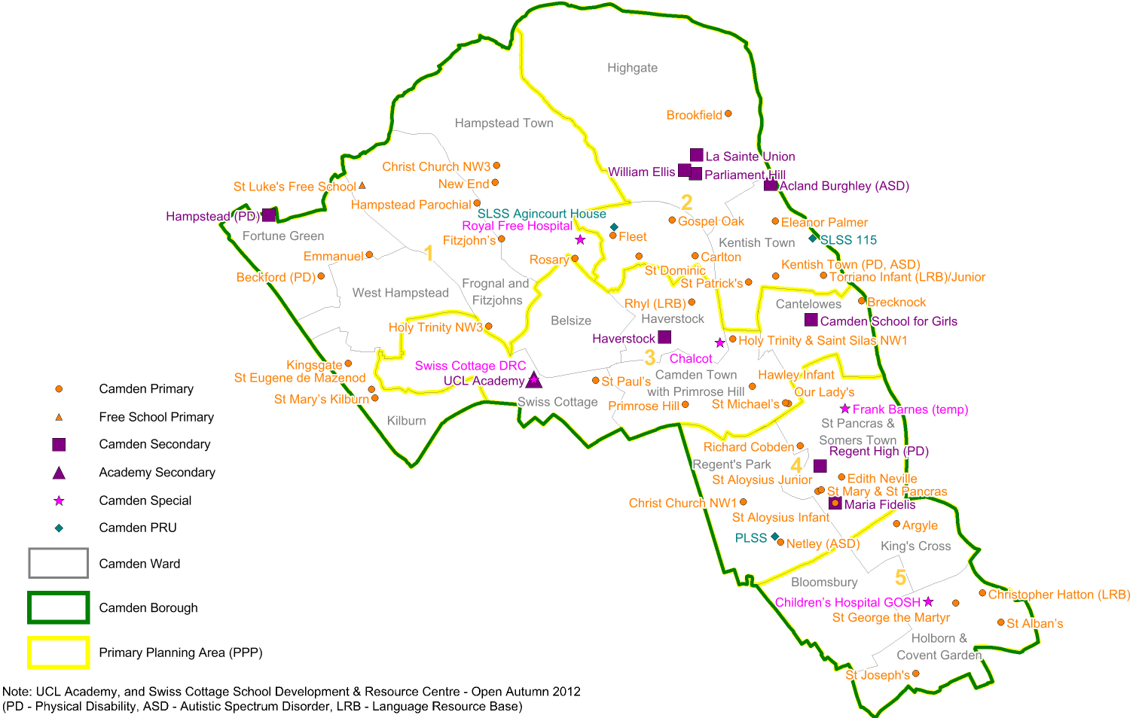
Primary
Argyle
Brecknock
Hawley
Holy Trinity & St Silas
Kentish Town
Netley
Our Lady & St Michael’s
Primrose Hill
Rhyl
St Patrick’s
Torriano
Brookfield
Christchurch
Eleanor Palmer
Emmanuel
Fitzjohn’s
Fleet
Gospel Oak
Hampstead Parochial
Kingsgate
Rhyl
Rosary
St Luke’s
St Mary’s
St Paul’s
Secondary
Camden School for Girls
Haverstock
Maria Fidelis
Regent High
Acland Burghley
Hampstead
La Sainte Union
William Ellis
University College London Academy (UCLA)
Notes:
Angela
In Camden MHST we work with most of the primary and secondary schools in the borough
Camden is a large borough and so we have a North Camden and a South Camden team – We are the South Camden team

Slide 7

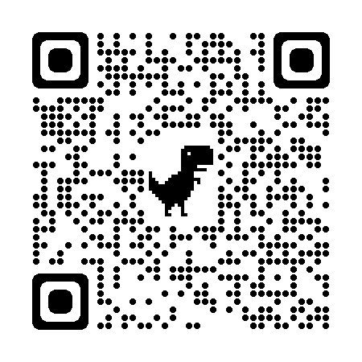
Parent and Carer Workshops
Advice for Parents and Carers at Universal Level
Webinar Series
Topics for Primary School Parents
Parent Self Care
Parent Child Interactions
Supporting Childhood Worries
Managing Routines
Therapeutic Conversations with your Child
Screen Time
All about Sleep
Supporting Transition to Secondary School
Sibling Relationships
Lunchtime and evening Sessions
Notes:
Angela
Refers parents to handout detailing full offer of webinars, Eventbrite page, remind that more topics are available, also for parents of children in secondary schools.
Optional script: the MHST Webinar series runs over the autumn and spring school terms. Webinars are interactive online workshops on a range of topics that parents and carers have told us would be useful to know about. Each w3binar runs for an hour, followed by an optional 30 minutes Q&A. The Webinars are usually held at midday with some evening sessions offered for popular topics.
A full list of the topic is available on our Eventbrite page, where you can also sign up and reserve your place. You can access this by scanning the QR code with your phone cameras now. If you point your phone camera to the screen a link will come up

Slide 8
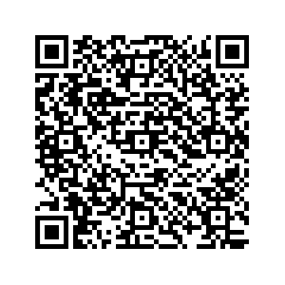

Other Workshops
Advice for Parents and Carers at Universal Level
In Person Workshop - Emotion Coaching
A 2-part In Person Workshop.
Emotion Coaching supports children to name and understand their emotions and teaches them ways to process and manage emotions in a helpful way.
In-School Coffee Mornings
Notes:
Angela
More advice information available through in person workshops like this one on Emotion coaching which is running next month – you can see more info in your handouts or by scanning the QR code with your phone camera.

Slide 9
Support for children of primary school age
Getting Help and advice at Universal level
In Class:
Zone Detectives: 8 sessions, focus on developing emotional literacy and self- regulation
            5 sessions, focus on self-regulation using mindfulness-based
            Approach
            School Assemblies
Notes:
Shany
At the whole class level we have two class in interventions: ZD which is an 8-week course teaching children about emotional regulation
And .breath which is a 4- week course teaching children about mindfulness and dealing with worry

Slide 10


Getting Help and Advice at Targeted level
Group Work
For Parents:
Incredible Years’ Parenting Programme
For Children:
Transition Group for Year 6 pupils
Key Stage 2 anxiety group
Notes:
Shany
For you or your child to access these groups you will need to complete a referral through school.
More information in the Incredible Years is found in the leaflets. This is a 12-week course for parent to build skills in managing their children’s behaviour
The transition group is aimed at children in year 6 who may need a little extra support in dealing with their thoughts and worries about moving to secondary school.
We also offer a group for children in KS2 who may need more support dealing with worry.

Slide 11
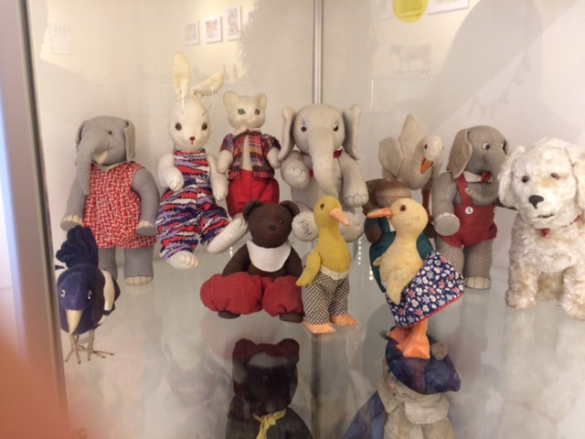
Getting Help and Advice at Individual level
For you and your child
I
Parent Led support for coping with childhood worries and fears
Parent Led support for children’s common behaviour problems
Personalised Individual Parent Training (PiPT)
Nurture intervention: 1:1 child directed play-based approach
Notes:
Shany
You may be confused as to how these ways of working are individual support for children.
Research tells us that children of primary school age are not quite at the right developmental stage to benefit from a short-term course of 1:1 therapeutic support.
While we may involve children in sessions, we mainly work with their adults.
You are the experts on your children and by working directly with you, your child will benefit from the support continuing beyond the sessions. Children spend most of their time at home, parents are best placed to support

Slide 12



Referral pathway
Who will be in the team soon…
Family GP
You can self-refer:
020 8938 2903
mhst@tavi-port.nhs.uk
School SENDCo
Grant Jacobson
Designated Mental Health Lead
Notes:
Angela
Add referral pathways - GP and self-referral an option, however best rout is via school . If for any reason you feel that you would want to have a chat with us, you can get in touch through the email address that we will advertise later. We can have a meeting at school or even call you back

Slide 13
What do people say about us?
Testimonials
Parents and young people who used the service said:
“You did a great job helping me and my anxiety.” - Primary school child
“I felt comfortable, being able to express my worries and concerns. It didn’t feel like I was being judged.” - Parent of primary school child
“I have found the sessions really helpful and learned new tools to put into practice.” - Parent of primary school child

Slide 14

Follow us on Instagram!

Slide 15

Further questions/Discussion
For those that have further questions or comments
Notes:
ADMIN

Slide 16

Notes:
ALL

