Slide 1
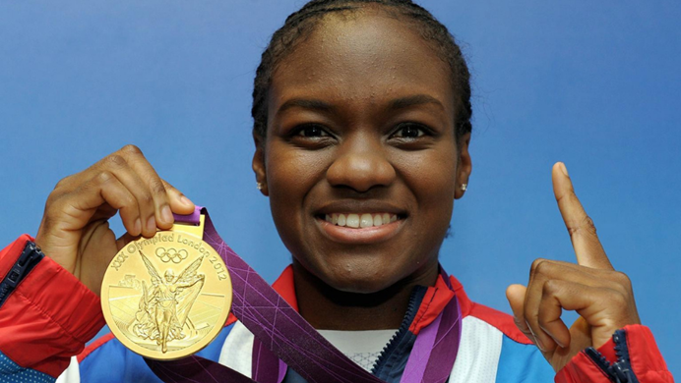
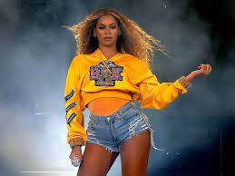
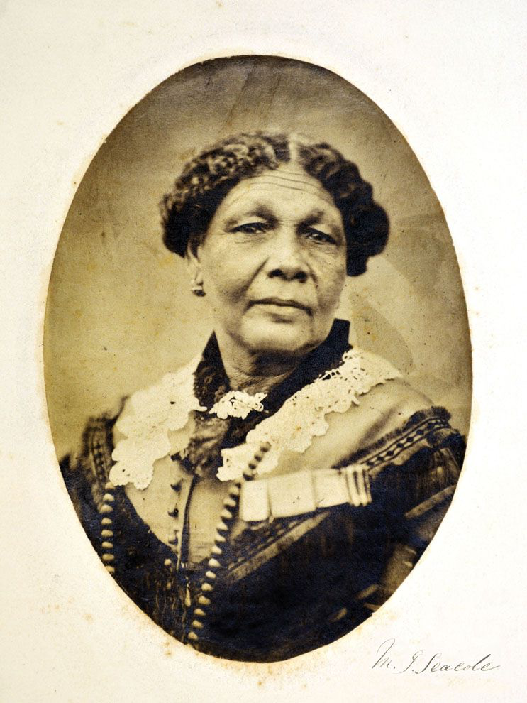
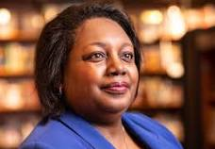
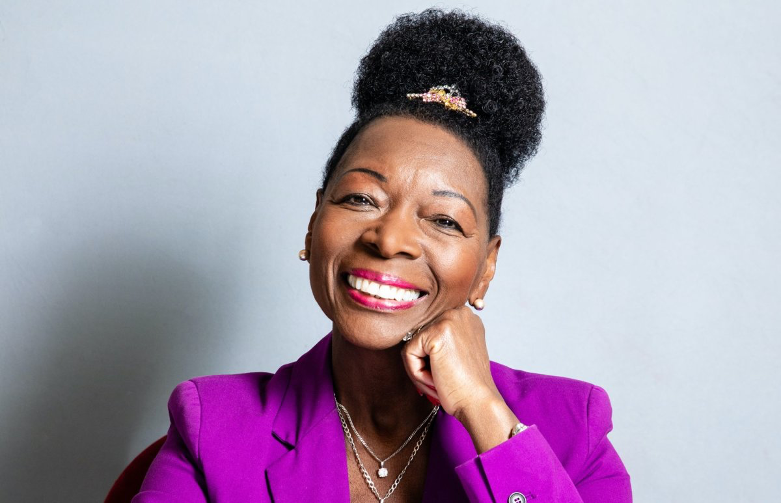
UNCRC Article 2: All children have these rights
Black History
Season 2023
Celebrating Our
Sisters
UNCRC Article 30: Every child has the right to learn and use the language customs and religion of their family
Notes:
https://youtu.be/mSmqvX7LrQ0?si=Ls67gpQMeZQlvhRr

Slide 2
Question Time
Do you recognise these amazing women?

Slide 3
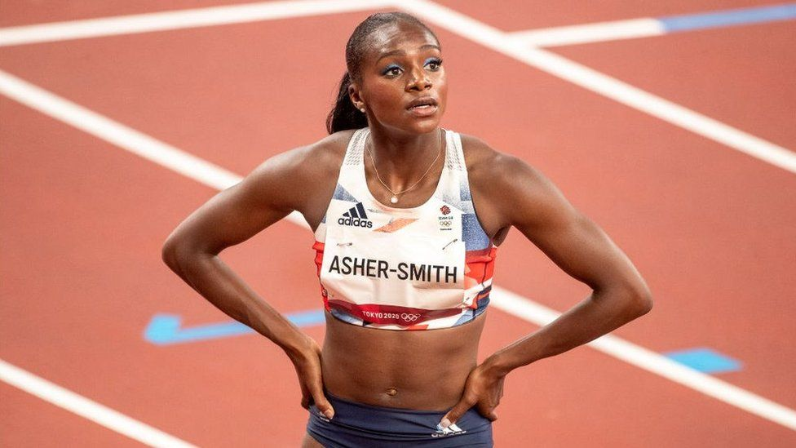
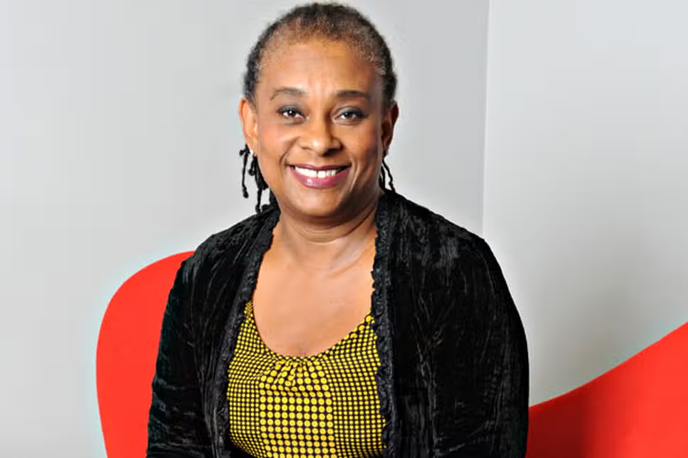

Slide 4
Nicola Adams
Baroness Floella
Benjamin
Alex Scott
Mary
Seacole
Dina Asher-Smith
Baroness Doreen Lawrence
Malorie Blackman

Slide 5
What do they all have in common?

Slide 6
All of these women have a skill and talent that has made them successful in
They are all successful because they are a have shown resilience ambition and bravery.
Sports
Acting and Presenting
Politics

Slide 7
Nicola Adams
Nicola Adams is a former professional boxer and a legend in the world of women’s boxing
In 2012 she made history by being the first woman to win an Olympic boxing Gold medal
She is a role model for aspiring athletes particularly in women’s sports

Slide 8
Baroness Floella Benjamin
Baroness Floella Benjamin is a famous British Actress and children’s television presenter
She is a dedicated champion for children’s rights and has helped many children’s charities
In 2001 she was presented with an OBE and she was made a Dame in 2020

Slide 9
What else do they all have in common?

Slide 10
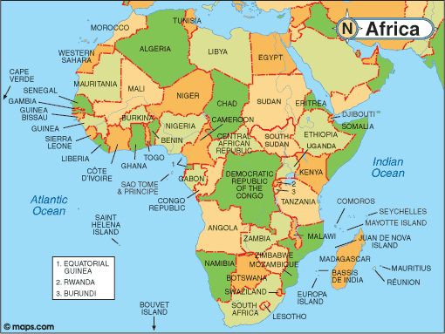
They are Black or of Mixed Heritage. They have African or Caribbean Roots
Africa
Caribbean

Slide 11
What is Black History Season?
Black History Season is a special time when we celebrate and learn about the incredible achievements of Black British people throughout history
It is a time when we learn about Black British people, who are not represented as much as white people in books, films and television
Celebrating Black History Season at our school also reminds us of the importance of having respect and tolerance for all cultures

Slide 12
Your Project
This year our theme for Black History Season will be ‘Celebrating our Sisters’
This means we will be learning about and celebrating Black and Mixed Heritage British women who have shaped history

Slide 13
Your Project

Slide 14
Prayer
Dear Lord,
Thank you that you have created us all to be ​equal. Please give us the courage and strength to ​stand up to unfair treatment, where other people's rights are not being respected.
Thank you that you give us all special gifts ​and talents, help us to always do our very ​best.
Amen

