Slide 2
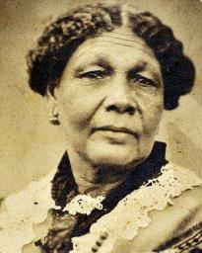
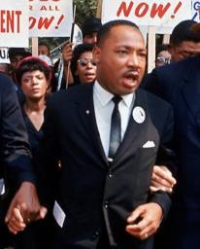
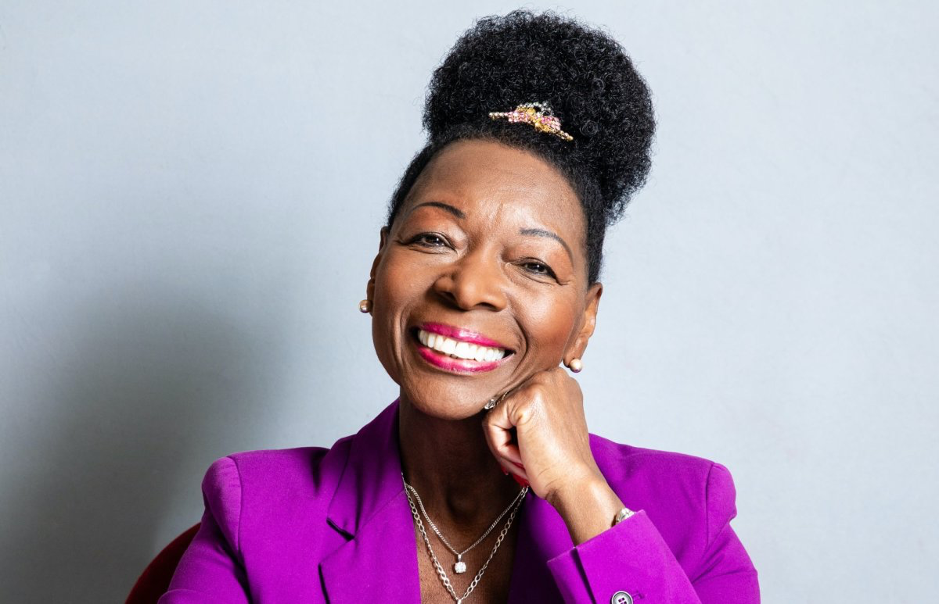
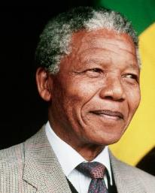
Martin
Luther
King
Baroness
Floella
Benjamin
Mary
Seacole
Nelson
Mandela

Slide 3
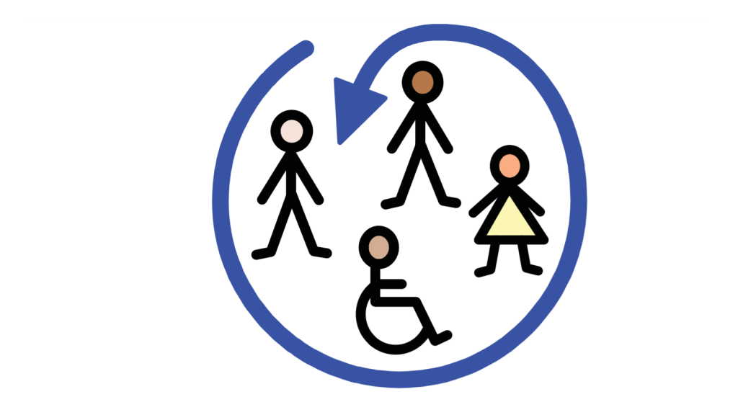
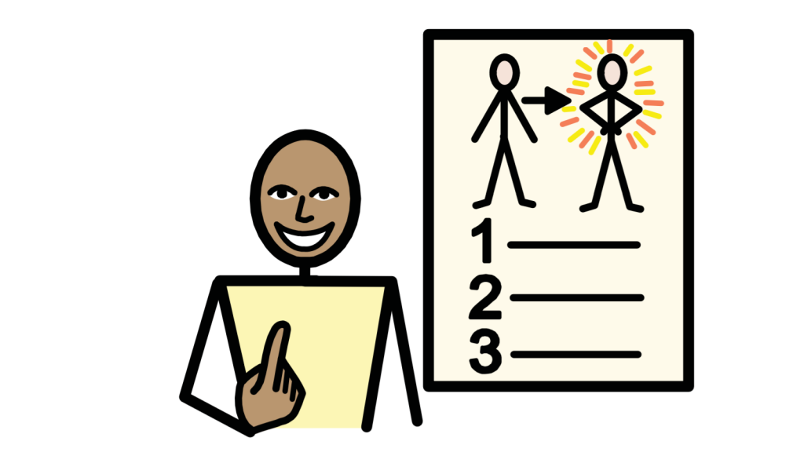
UNCRC Article 2: All children have these rights
UNCRC Article 19: I have the right to be protected from being hurt or badly treated
UNCRC Article 30: I have the right to speak my own language and follow my family’s way of life
UNCRC Article 29: I have the right to an education which develops my personality, respect for others’ rights and the environment

Slide 4
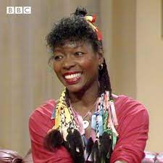
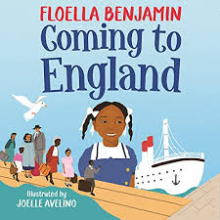
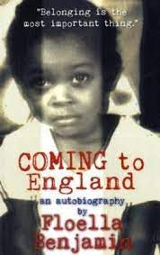
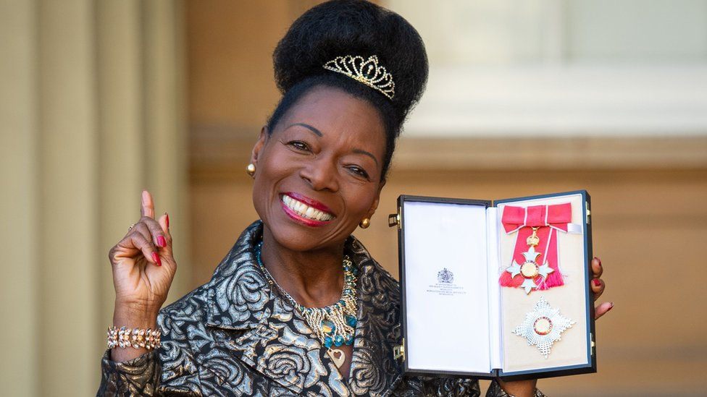
Baroness Floella Benjamin

Slide 5
https://www.bbc.co.uk/cbeebies/watch/cbeebies-bedtime-stories-david-olusoga-coming-to-england

Slide 8
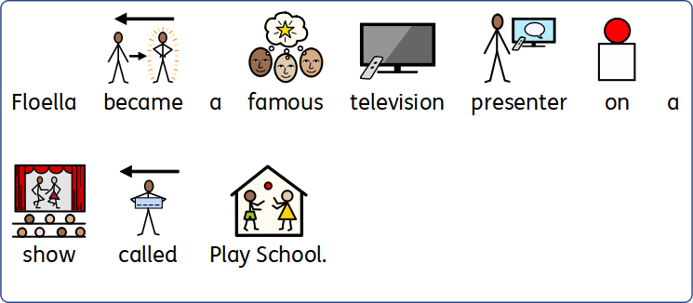

Slide 9
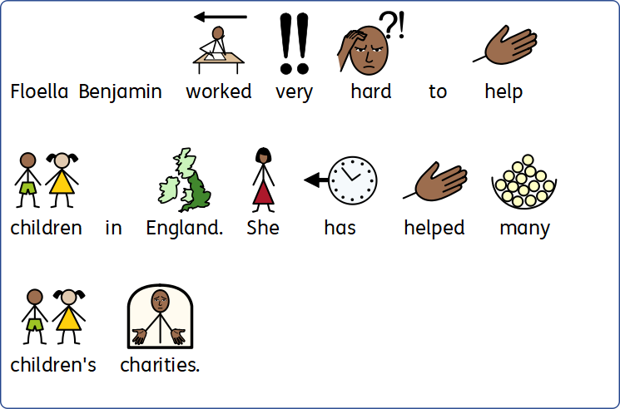

Slide 10
