Slide 1
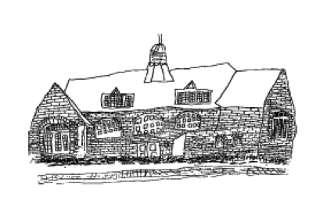

Slide 3
What is Black History Month?
Black History Month is a time set aside each year to celebrate the achievements of Black people in the past and today.
Black people have not always been treated equally simply because of their race. One example is that in America, Black and White people had to sit in different seats on a bus or public places, like the cinema.
Lots of people knew that this was wrong and wanted things to change.
In the UK, a movement began in the 1980s as part of a local community activism to challenge racism.
In 1987, this turned into what we know today as Black History Month.

Slide 4
When is Black History Month?
Every October
It is an opportunity to raise awareness of Black history, traditions and contributions through celebration, events and education.

Slide 5
What is the theme this year?
This year's theme for Black History Month is “Time for Change: Action Not Words” – calling on people to actively tackle racism, reclaim Black history, and ensure Black history is represented and celebrated all year round
We are going to be finding out about some famous black people who have done something that has brought about change in the UK

Slide 6
What do we do?
Find out about the person assigned to your class and create a project at home over the half term.
You can present your project as: a poster, leaflet, book, a piece of art or any other creative way you can think of!

Slide 7
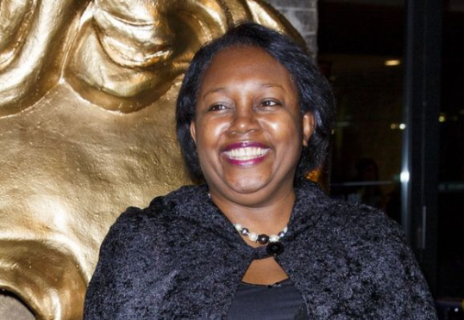
Malorie Blackman – Ash Class
You may well have heard of best-selling author of the Noughts & Crosses series - Malorie Blackman.
When she was chosen to become the eighth Children's Laureate, she became the first black person to take on the role.
Malorie says she wanted to "make reading irresistible" for children, by encouraging them to explore a range of literature, from short stories to graphic novels.

Slide 8
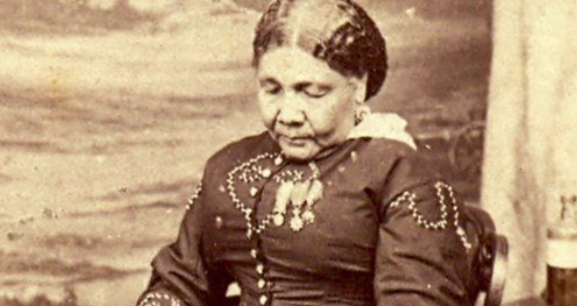
Mary Seacole – Willow Class
Mary Seacole was born and grew up in Jamaica, but came over to England in 1854.
She asked the War Office if she could go to help wounded soldiers who were fighting in the Crimean War (1853-1856), but she wasn't allowed.
So she raised the money herself and travelled to the Ukraine. Here, she looked after British soldiers who had been injured.

Slide 9
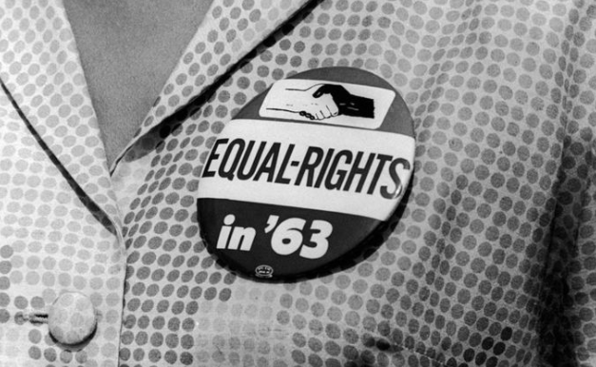
Olive Morris- Cedar Class
Olive Morris was an important figure in terms of civil rights.
Black people didn't used to have the same rights as other people, simply because of the colour of their skin - and Olive was one of many people who worked tirelessly to change that.
She campaigned for the rights of black people in South London and Manchester.

Slide 10
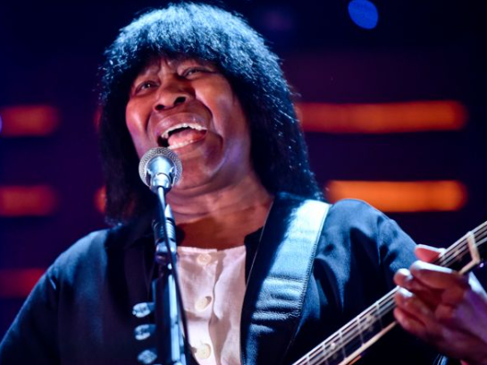
Joan Armatrading- Sycamore Class
Armatrading was the first ever female UK artist to be nominated for a Grammy in the blues category. She went on to be nominated three times.
She arrived in the UK at the age of seven, from the Caribbean island of Saint Kitts. She started writing songs at the age of 14. She also taught herself to play the guitar.
In 2007, she became the first female UK artist to debut at number 1 in the Billboards blues chart (which is like the top 40 chart for blues music in America).

Slide 11
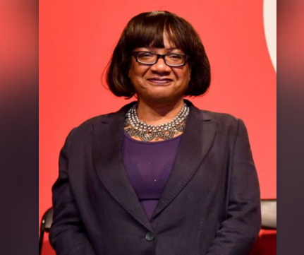
Diane Abbott- Chestnut Class
In 1987, Diane Abbott made history by becoming the first black woman ever to be elected to Parliament.
She also started the London Schools and the Black Child programme, which aims to help black children to do well in school.
She still serves in Parliament to this day as one of the main politicians in the Labour party.

Slide 12
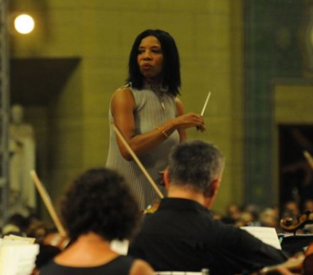
Dr Shirley Thompson- Beech Class
Only recently, Dr Shirley Thompson was named as "one of the most inspirational Black British women" by the newspaper Metro.
In 2004, she became the first woman in Europe to conduct and compose a symphony within the last 40 years. It was called New Nation Rising, A 21st Century Symphony.
The piece of music celebrated London's history and was composed to mark the Queen's Golden Jubilee in 2002.

Slide 13
The Final Projects
After half term, we will display all the projects
Each class will have time for a gallery walk
Parents and carers will be invited in to view the work too ON FRIDAY 4TH NOVEMBER!

